Slide 1
Final Year Project Network Monitoring System
Team Members:
IT114104-2A SIU Man Ho
IT114104-2B IU Hiu Pan
IT114104-2B TAM Siu Kei
IT114104-2B LAU Chun Yin

Slide 2
Background
Company putting their services on internet
Server becomes a very important component
Affect the normal function of the company
Cause huge economic losses

Slide 3
What is SNMP?
Application Layer protocol (Layer7)
Manage the device on IP address
UDP 161
Versions(SNMPv1,SNMPv2c,SNMPv3)

Slide 4
SNMPv1
First version of SNMP
Only require a string community
Community are sent in plaintext
Only supports 32bit counters,

Slide 5
SNMPv2c
Identical to version 1
Added a 64 bit counters
Limited security
Most common

Slide 6
SNMPv3
Adds authentication and encryption
Need user account
Encrypt the data packet
More secured

Slide 7
Component of SNMP
MIB
OID
Agent
Community

Slide 8
MIB
A database in device.
With the set of ‘objects’.
These ‘objects’ store device status
Identified by ‘OID’

Slide 9
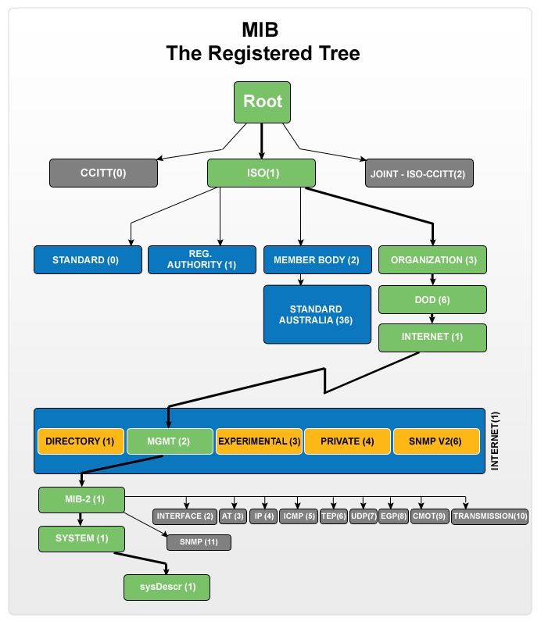
OID
A set of number
Identify objects in MIB

Slide 10
Agent
Program installed in device
Like a middleman
Communicate with device
Collect the appropriate object in MIB

Slide 11
Community
A set of String
Like a user password
Allow access to devices
Configured in the device

Slide 12
Requirements
Devices status capturing
Manually and Automatically
GUI
Status Statistics
Record History
Network Scanning
Report Generating

Slide 13
Tools and Equipment
SNMP4J
JFreeChart
JDBC
Apache-P01
Net-Snmp
Window and Centos
Cisco Router and Switch

Slide 14
Capture Parameter
Linux:
IP address
System Name and Uptime
RAM
CPU loading
Hard Disk
Network Traffic

Slide 15
Capture Parameter
Windows:
IP address
System Name and Uptime
RAM
CPU loading
Hard Disk

Slide 16
Capture Parameter
Cisco Router:
IP address
System Name and Uptime
CPU
Port Status
Network Traffic
Packet Traffic

Slide 17
Capture Parameter
Cisco Switch:
IP address
System Name and Uptime
Port Status
Network Traffic
Packet Traffic

Slide 18
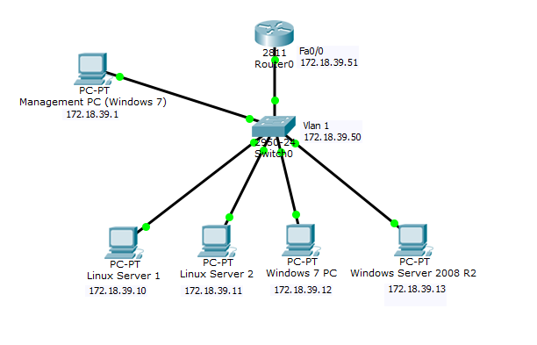
Network Diagram

Slide 19
DEMO

